Slide 1
TOPIC 7:
CONTROL SYSTEMS
LESSON 7-3
IMPACTS OF CONTROL SYSTEMS

Slide 2
AGENDA
Electronic Tagging
Surveillance/CCTV
Improved Safety Systems
NOTE!
Have a way to take notes available for this lesson

Slide 3

THE WARM UP QUESTION
Define sensor, actuator, and transducer

Slide 4
THE WARM UP ANSWER
Sensor: converts physical (analog) quantities (such as speed, temperature, humidity, pressure, etc.) into discrete digital signals using an analog to digital converter
Actuator: devices responsible for moving some kind of mechanics. Receive an electric current and convert it to motion
Transducer: a device that converts one form of energy to another. Both sensors and actuators are transducers.

Slide 5

SOCIAL IMPACTS
Because many control systems are automated and mass implemented, this can lead to a variety of social impacts
We’ll be exploring a few of these today

Slide 6

ELECTRONIC TAGGING
Offenders who are
Guilty of minor offences
Entitled to leave time
Under house arrest
In these cases, the individuals might be tagged with an electronic monitoring device
Anklets that use GPS can allow officers to know their positions at all times
Tampering with it triggers an alarm

Slide 7
ELECTRONIC TAGGING
Pros:
Overcrowded jails can impede their effectiveness
Shown to effectively deter crime
Offenders are less likely to do crime while monitored
Less money spent on jail expenses/officers
Allow offenders to rejoin society sooner

Slide 8
ELECTRONIC TAGGING
Cons:
Lenient punishment
Doesn’t physically restrain
They could re-commit once easily
Requires large monitoring task force if there are many
Need officers at the ready if the tracker sets off an alarm
May add psychological pressure to wearer

Slide 9
ELECTRONIC TAGGING
Other notes:
Can be used outside of criminal space
Track whereabouts of people with Alzheimer’s

Slide 10
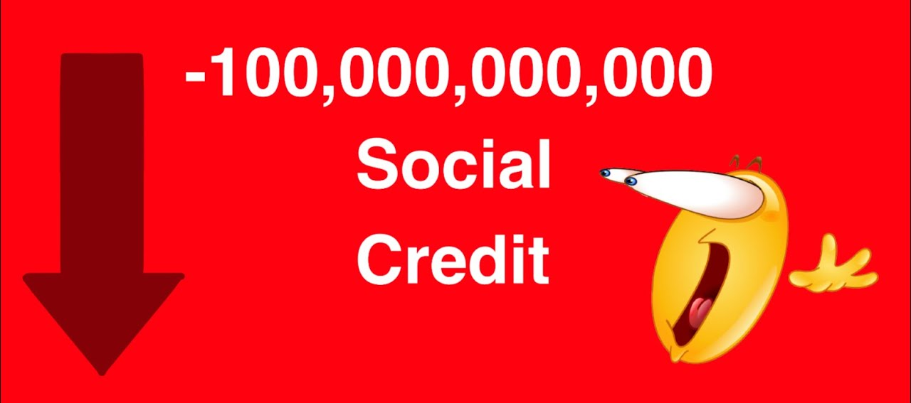
SURVEILLANCE/CCTV
Recently, a large number of cameras have began being installed on highways and cities in various countries and cities
Often near traffic lights and intersections
Recently, we’ve added facial recognition to these using AI and algorithms
License plate recognition as well
Lets us track individual people’s travels

Slide 11
SURVEILLANCE/CCTV
Pros:
Decrease crime
Violent crime
Robberies
Traffic crime

Slide 12
SURVEILLANCE/CCTV
Cons:
CCTV cameras can reduce privacy if there are too many
Tracking information can be breached by hackers

Slide 13
SURVEILLANCE/CCTV
Questions:
Does surveillance actually reduce crime, or does it just move it to non-surveilled areas like indoors?
Should workplaces install CCTV to monitor their workers?
Should schools install CCTV to monitor students?
Are citizen rights (privacy) more important than prevention of potential wrongdoing?

Slide 14
IMPROVED SAFETY SYSTEMS
As we have developed control systems, we have been able to use them to improve safety of many mechanism.
What are some examples of mechanisms or systems that have greatly improved in safety in the past 50 years?
What of this is due to control systems?

Slide 15
IMPROVED SAFETY SYSTEMS
Examples:
Elevators – too much weight sensed will prevent the elevator from moving
Cars – motion detectors to deploy airbags during a crash

Slide 16
IMPROVED SAFETY SYSTEMS
Sometimes these systems fail, and in these instances we revise them to be even more safe
Initially, cars only had front airbags
We realized that the airbags only worked from the front
If a car gets hit from the side, they are ineffective
In response, introduce side airbags into the system

Slide 17
IMPROVED SAFETY SYSTEMS
Another example:
Previously, when brakes were hit too hard, the wheels would lock instead
Now, the Anti-lock breaking system was developed (ABS)
Prevents wheels from locking and skidding, which decreases stopping distances

Slide 18
NOW FOR YOUR EXAMPLE
What’s another example of a control system like this that might have some social impacts?
Decide on one and then:
Identify the components of the system itself
Identify some social pros
Identify some social cons
Ask at least one question about that system’s role

Slide 19

VOCAB TO REMEMBER
Electronic Tagging
Surveillance
Safety Systems

